Slide 1
Real Time Data Analysis
major.baek@lge.com

Slide 2

Gallog
Gather log
Analyze log
Load log

Slide 3

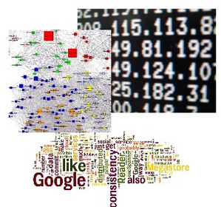
Streaming Data
Mapped Objects
100 events / second
360k per hour
8.6 M per day
260 M per month

Slide 4

CJ 마케팅 분석
월요일 오후 2시 16분이 가장 피곤 → “피곤한 월요일 2시 16분, 푸딩 하자!”

Slide 5



General Architecture
events
Collecting
Analysis
Query
Simple?
Too many events
Never ending
report
What’s the favorite color in this year?
1000
petabytes

Slide 6
Log Collecting

Slide 7
logback
log4j / log4j2 / slf4j
log stash
LMAX Distrupter
syslogd
disk file I/O
web logs
API server logs
Debug logs
Monitoring logs
Sensor logs
Offline logs
....
File logs
Console logs
Memory logs
Formatting
Flume
Fluentd
Thrift
Avro
Queue SDK
Socket I/O
Distributed Queue
Apache Kafka
Amazon Kinesis

Slide 8
**Note
Avro / Thrift
Lightweight Application Server
Platform Independent Data Exchange
Flume
Continuous Data Ingestion System
Fluentd / Log4j / Log4j2
Log Collector
LMAX Disruptor
No Locking Circular Queue
Log4j2 Asynchronous Logging

Slide 9
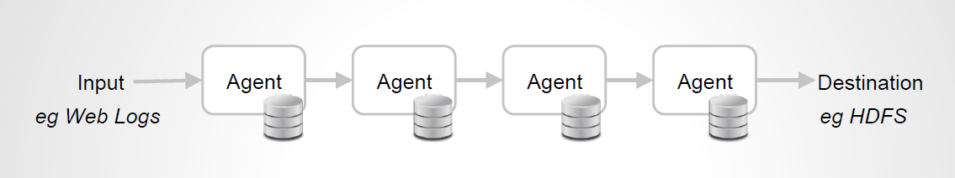
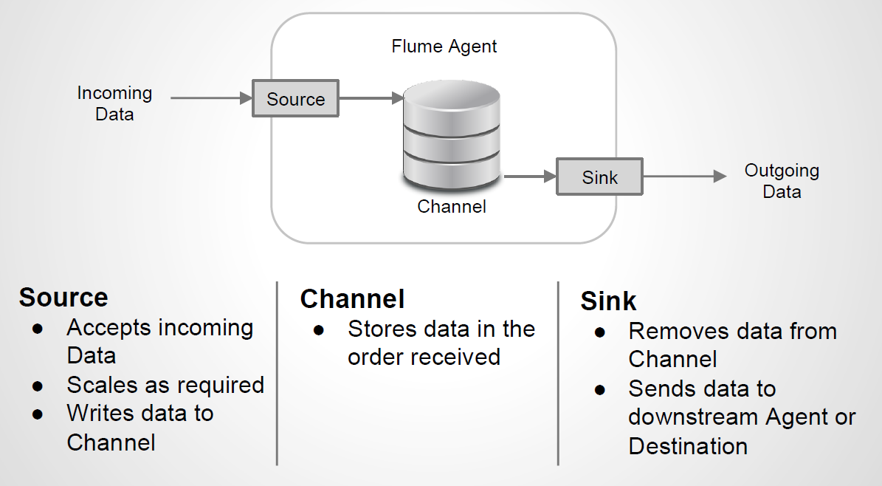
**Apache Flume

Slide 10
**Apache Flume
Source
Channel
Sink
Avro
Thrift
Exec
JMS
Twitter
Netcat
Syslog
HTTP
Scribe
Custom
Memory
JDBC
File
Custom
HDFS
Avro
Thrift
HBase
ElasticSearch
File
IRC
Custom

Slide 11
agent.sources = socketSource execSrc
agent.channels = myChannel
agent.sinks = memSink
agent.sources.socketSource.type = avro
agent.sources.socketSource.bind = 0.0.0.0
agent.sources.socketSource.port = 3333
agent.sources.socketSource.channels = myChannel
agent.sources.execSrc.type = exec
agent.sources.execSrc.command = tail -F /home/major/test.log
agent.sources.execSrc.batchSize = 5
agent.sources.execSrc.channels = myChannel
agent.channels.myChannel.type = memory
agent.channels.myChannel.capacity = 1000
agent.channels.myChannel.transactionCapacity = 100
agent.sinks.memSink.type = MySink
agent.sinks.memSink.channel = MyChannel

Slide 12
Log Criteria
Asynchronous logging
Detach Producer / Consumer
Minimize Disk I/O
Linux Buffer Cache Flushing Problem
Minimize Lock Control
Log Event Queue Lock Management
Minimize OS System Call
Zero Copy : User/Kernel Mode Memory Copy
Block Device / Character Device / Socket
Reduce Unnecessary Load
if (LOGGER.isInfoEnabled()) { LOGGER.info(MESSAGE_PREFIX + Math.random() + MESSAGE_SUFIX); }
Why we need to minimize system call in Amazon EC2 instance ?

Slide 13
**Virtualization
CPU
Kernel Mode Instruction Management
Full Virtualization
Guest OS binary translation
Para Virtualization
Hyper Call
HVM
VT op set
Amazon EC2 instance: HVM & Para Virtualization
Memory
Virtual Page Table: MMU, Virtual TLB
note) EC2 instance memory size: 3.75 GB, 7.5 GB....
I/O Device
Device Emulation

Slide 14
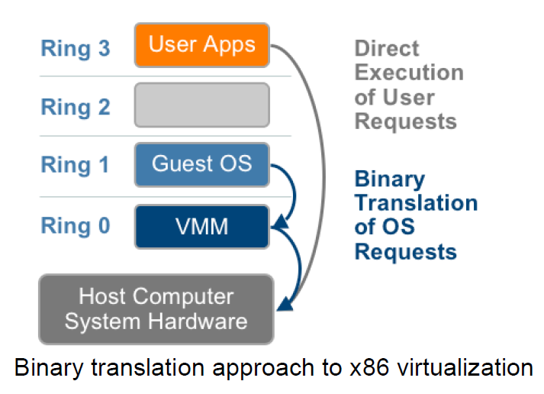
Full Virtualization

Slide 15
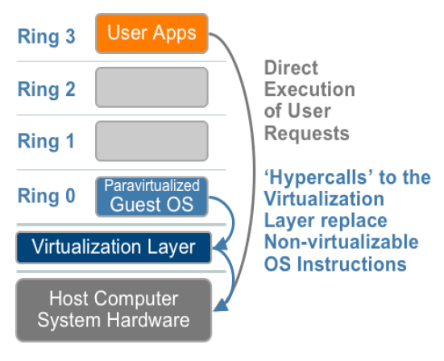
Para Virtualization
Modify guest OS kernel to replace privileged instruction with hypercall
→ Note) Amazon Linux AMI

Slide 16
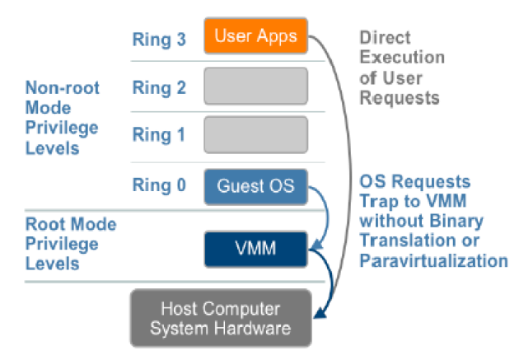
HVM
since 2006, Intel VT-x, AMD V

Slide 17
Amazon EC2 Virtualization
Para Virtualization
Guest OS Kernel Modification
Kernel Mode System Call → Hyper Call
User Mode → Native
HVM
Hardware Virtualization
No Guest OS Kernel Modification
Kernel Mode System Call
Processor VT op-code call

Slide 18
Log Definition
Type
Application Log
Created using log library
error / warning / info / debug
System Log
File based system log
proc fs, tomcat log etc
stderr / stdout output

Slide 19
Log Library Example (1)
Usage Examples
<Simple line log>
Logger logger = LogFactory.getLogger(“uuid”, “com.apps.module”);
logger.error(“blablabla”);
logger.warning(“hello warning”);
logger.info(“Info string”);
logger.debug(“argument zero”);
Send error log →
Send warning log →
Send info log →
Send debug log →

Slide 20
Log Library Example (2)
Usage Examples
<Transaction log>
Logger logger = LogFactory.getLogger(“uuid”, “com.apps.module”);
TLog tlogger = logger.createTransactionLog();
tlogger.error(“blablabla”);
tlogger.warning(“hello warning”);
tlogger.info(“Info string”);
tlogger.debug(“argument zero”);
tlogger.commit();
Add transaction log →
Add transaction log →
Add transaction log →
Add transaction log →
Send transaction log →

Slide 21
Log Library Criteria (1)
Latency
Producing time: Tp
Consuming time (pre-process, net send): Tc
Tc >> Tp
High latency makes application block or consume large memory for log event queue
For low latency
Single Producer & Multiple Consumer

Slide 22
Log Library Criteria (2)
log4j vs log4j2
log4j
High latency at enterprise level
Memory leak / Dead lock problem
Simple & Old
log4j2
Low latency: Async log model (Full async / Async appender)
Appender tuning: Not easy
Make some latency between log4j2 core and custom appender

Slide 23
Log Library Criteria (3)
Custom Library
Easy usage
Asynchronous logging: For low latency
Minimize consumer customization effort
Thread safe
Consumer tuning for a large log

Slide 24
Log Library Criteria (4)
Build Custom Library
Internal Data Structure: LMAX Disrupter
Low latency circular queue
Thread safe
Log4j2 core library
Support Transaction Log
Performance Tuning
1 Producer N consumer: N is configurable
Easy Maintenance

Slide 25
Log Agent Modeling 1
tomcat log file
import log library
Service Code
tail –f /tmp/log/tocat.log
exec source
Flume
Agent
call log api
memory channel
custom sink
Log Agent
Event Sender
Log Agent
Event Sender
Kafka
Server
Process
Process

Slide 26
Log Agent Modeling 2
tomcat log file
import log library
Service Code
tail –f /tmp/log/tocat.log
exec source
tail –f /tmp/app.log
Flume
Agent
call log api
memory channel
custom sink
Log Agent
File Writer
Log Agent
Event Sender
Kafka
Server
service log file
Process
Process

Slide 27
Log Agent Modeling 3
tomcat log file
import log library
Service Code
tail –f /tmp/log/tocat.log
exec source
localhost
tcp
Flume
Agent
netcat source
call log api
memory channel
custom sink
Log Agent
Flume Sender
Log Agent
Event Sender
Kafka
Server
Process
Process

Slide 28
**log4j 2 Modeling
tomcat log file
import log4j2 library
Service Code
tail –f /tmp/log/tocat.log
exec source
loalhost
port 3333
Flume
Agent
avro source
call log4j 2 api
memory channel
custom sink
Flume Appender
avro
Log Agent
Event Sender
Kafka
Server
Process
Process

Slide 29
Unix Domain Socket
Local IPC: Socket vs Unix Domain Socket
Socket
CPU overhead for packet header parsing
Unix Domain Socket
Socket Interface
But, kernel knows this socket is for local host inter-network
No packet header
Direct copy payload to target socket buffer
Mapped to special file
Linux: Support anonymous uds file
Java supports unix domain socket
Do NOT support anonymous uds file

Slide 30
Flume Unix Domain Socket
Build domain socket reader
Fast execution: C implementation
Read message and print to stdout
ex) my_uds_reader.c
Flume exec source
Run UDS reader c binary: my_uds_reader
Capture stdout and send it to memory channel

Slide 31
Log Agent Modeling 4
tomcat log file
import log library
read_uds:
receive event from domain socket, print to stdout
Service Code
tail –f /tmp/log/tocat.log
exec source
Flume
Agent
exec source
call log api
memory channel
custom sink
Log Agent
Unix Domain Socket Writer
Log Agent
Event Sender
Kafka
Server
Process
Process

Slide 32
Log Agent Core: Candidate 1
import custom log library
write to uds / send to kafka
Service Code
Queue Consumer Thread 0
call custom log api
Queue Consumer Thread 1
async return
push
push
Queue Consumer Thread 2
LMAX
Disrupter Queue
push
Publish event to Queue
Number of consumer
→ Defined by latency & Queue level

Slide 33
Log Agent Core: Candidate 2
import log4j 2 library
write to uds / send to kafka
Service Code
Queue Consumer Thread 0
call log4j 2 api
Queue Consumer Thread 1
log4j 2 configuration
Async mode setting
Double Buffring
push
Custom Appender
push
Queue Consumer Thread 2
LMAX
Disrupter Queue
push
async return
Publish event to Queue
Number of consumer
→ Defined by latency & Queue level

Slide 34
Distributed Coordinator
Google Chubby
Distributed Lock Mechanism
Google Paper
Apache Zookeeper
Implementation of Chubby
Service Synchronization
Change Notification
Common Tool
Must be familiar..

Slide 35
Distributed Queue
Independent
Do not affect to producer / consumer
Scalability
Clustering
Replica
Durability
Consumer failure & No data loss
Reprocessing
Batch / Real time

Slide 36

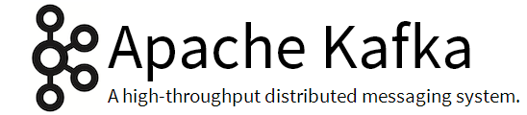
service1
service2
service3
flume
custom library
flume
flume
Log Agent
Log Agent
Log Agent
kafka producer API
kafka producer API
kafka producer API
service log
Apache
Kafka
kafka topic
kafka topic
kafka topic
single node
multi broker
cluster
server
server
server
server

Slide 37
service1
service2
service3
flume
custom library
flume
flume
Log Agent
Log Agent
Log Agent
kinesis service API
kinesis service API
kinesis service API
service log
Amazon
Kinesis
kinesis shards
1st Filter
Critical Error Alarm
S3/ES export
Storm spout
EC2
auto scaling group
kiness application
kiness application
kiness application

Slide 38
Apache Kafka
Producer
Producer
Broker
Broker
Zookeeper
Broker
Broker
Consumer
Consumer

Slide 39
Kafka Terminology
Topic = message stream
Topic have partitions
partitions are distributed to
brokers
Partition has a log on disk
messages are persisted in log
messages are addressed by offset

Slide 40
Kafka Replica and Layout
Partition have replicas
Replicas spread evenly among brokers
logs
logs
logs
logs
topic1-part1
topic1-part2
topic2-part1
topic2-part2
topic2-part2
topic1-part1
topic1-part2
topic2-part1
topic2-part1
topic2-part2
topic1-part1
topic1-part2
broker 1
broker 2
broker 3
broker 4

Slide 41
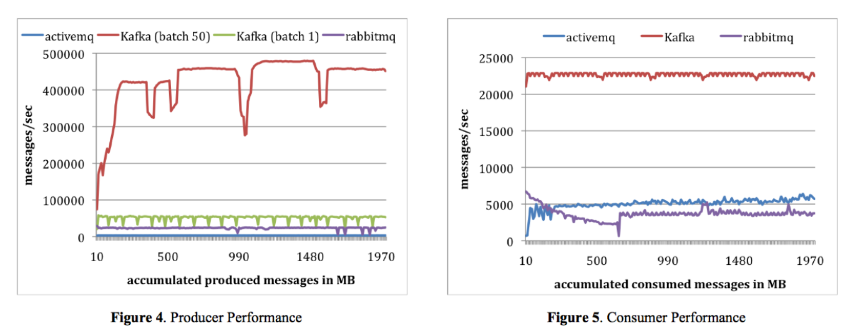
Kafka Performance

Slide 42
public class SimpleProducer {
private static Producer<Integer, String> producer;
private final Properties props = new Properties();
public SimpleProducer() {
props.put("metadata.broker.list", "wilson:9092, wilson:9093");
props.put("serializer.class", "kafka.serializer.StringEncoder");
//props.put("partitioner.class", "SimplePartitioner");
props.put("request.required.acks", "1");
producer = new Producer<Integer, String>(new ProducerConfig(props));
}
public static void main(String [] args) {
SimpleProducer sp = new SimpleProducer();
Random rnd = new Random();
String topic = (String)args[0];
for (long messCount = 0; messCount < 10; messCount++) {
Integer key = rnd.nextInt(255);
String msg = "This message is for key - " + key;
System.out.println(msg);
KeyedMessage<Integer, String> data1 =
new KeyedMessage<Integer, String>(topic,key, msg);
producer.send(data1);
}
producer.close();
}
}

Slide 43
public void testConsumer() {
Map<String, Integer> topicCount = new HashMap<String, Integer>();
topicCount.put(topic, new Integer(1));
Map<String, List<KafkaStream<byte[],byte[]>>> consumerStreams =
consumer.createMessageStreams(topicCount);
List<KafkaStream<byte[],byte[]>> streams = consumerStreams.get(topic);
for (final KafkaStream stream : streams) {
System.out.println("Main Loop");
ConsumerIterator<byte[], byte[]> consumerItr = stream.iterator();
while (consumerItr.hasNext()) { //Blocking
String msg = new String(consumerItr.next().message());
System.out.println("Message from Single Topic:: " + msg);
if (msg.equals("exit")) break;
}
}
if (consumer != null)
{
consumer.shutdown();
}
}

Slide 44
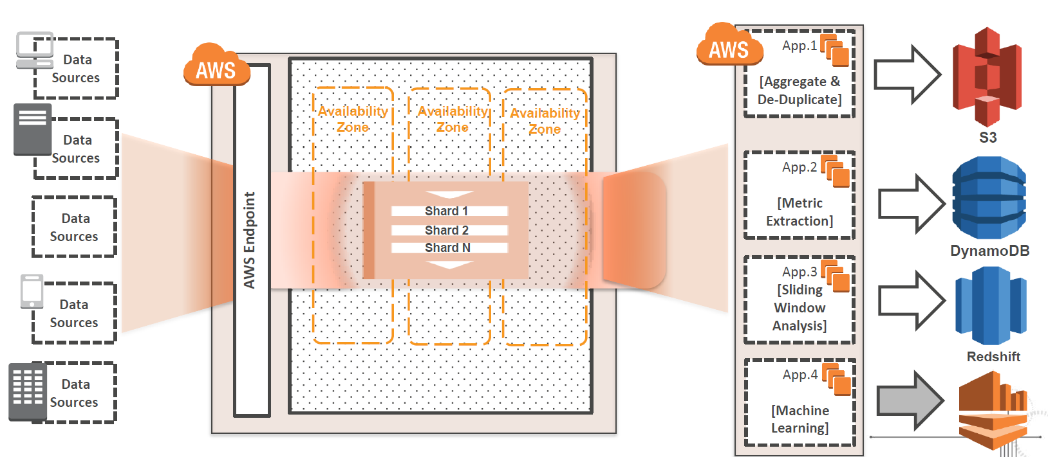
Amazon Kinesis

Slide 45
Kinesis Terminology
Data Record
The units of data that are stored in an stream
Stream
An ordered sequence of data records
Unique stream name
Shard
A group of data records in kinesis stream
Virtual database
A shard: 5 read/sec, 2 MB read/sec, 1000 write/sec, 1 MB write/sec
24 hour replay
Partition Key: Shard identifier
Kinesis Application & KCL

Slide 46
Kinesis is just
Shards + KCL Application

Slide 47
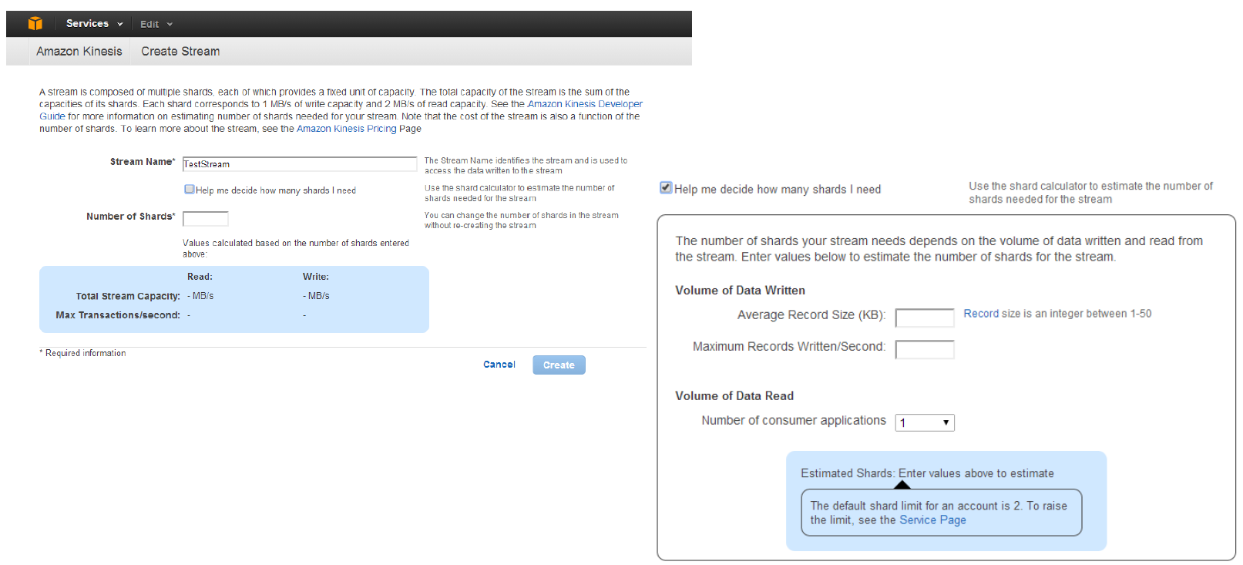
stream name &
number of shard
stream name: unique in service – mapped to Dynamo table name
number of shard: carefully calculate – it’s money

Slide 48
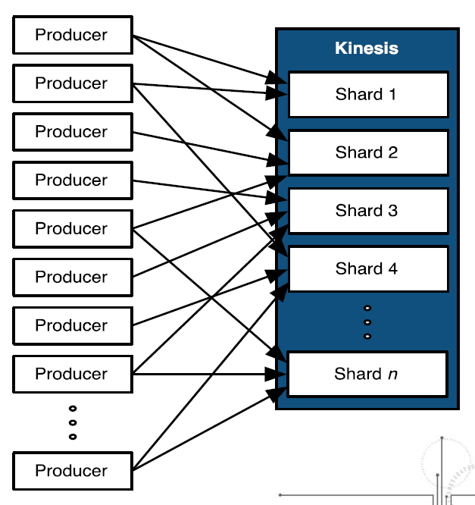
PutRecord
{Data, PartitionKey, StreamName}
PartitionKey : Shard number

Slide 49
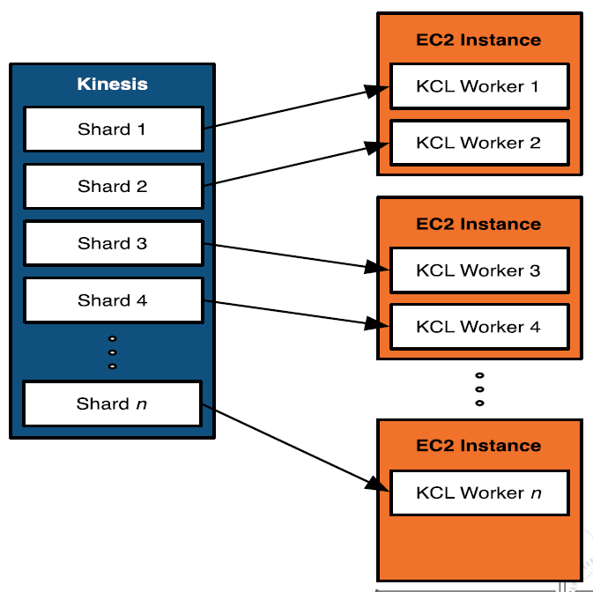
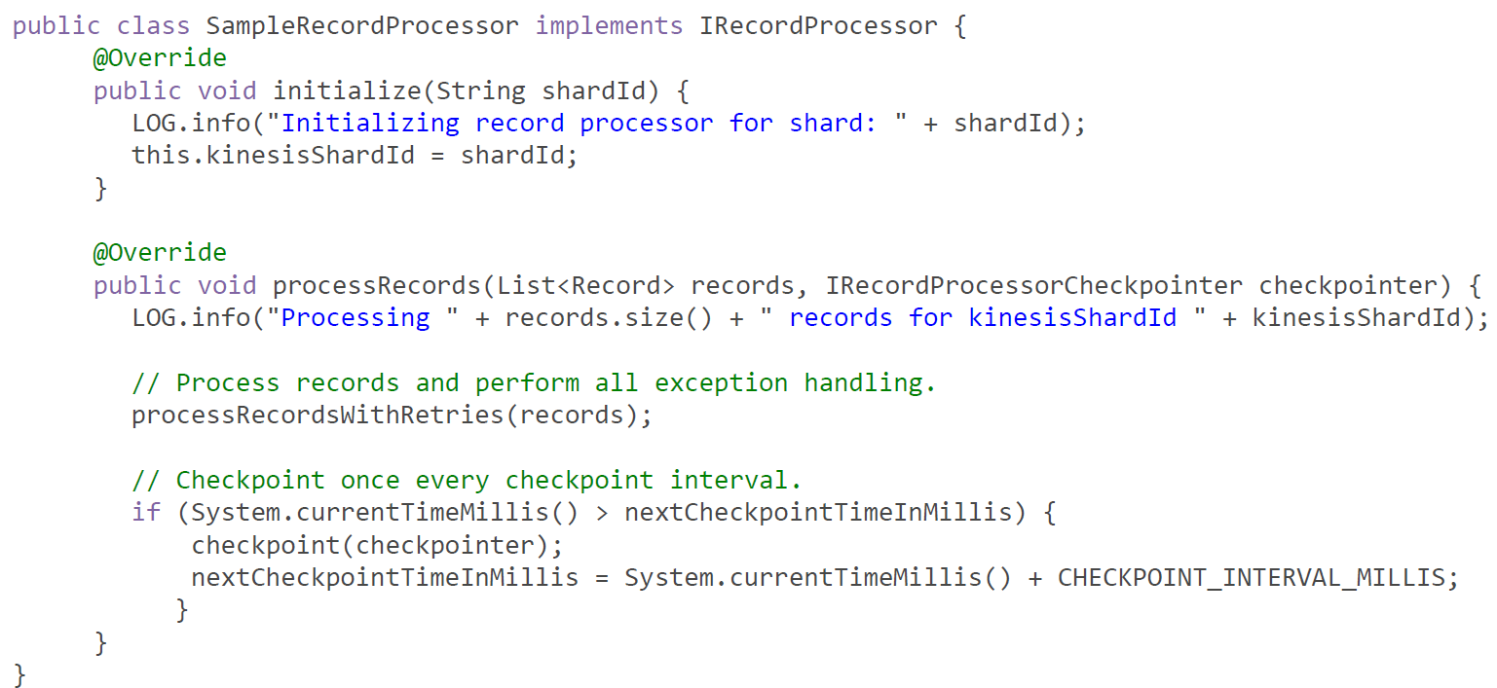
Kinesis Application
DataRecord Consumer
Using KCL
- Kinesis Client Library

Slide 50
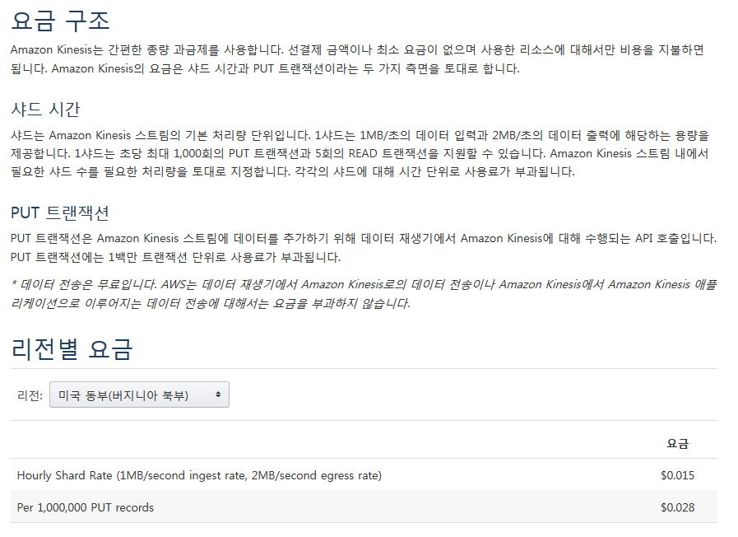
kinesis

Slide 51
Kinesis vs Kafka
kinesis
Maintained by Amazon
Work with
Cloud Watch
S3 : S3 connector
Elasticsearch : ES connector
Storm : kinesis storm spout
Best for first level filtering
kafka
The classic: Almost every real time systems uses it.
Development Effort < kinesis
Maintenance Effort(Scalability, Tuning) > kinesis

Slide 52
Analysis

Slide 53
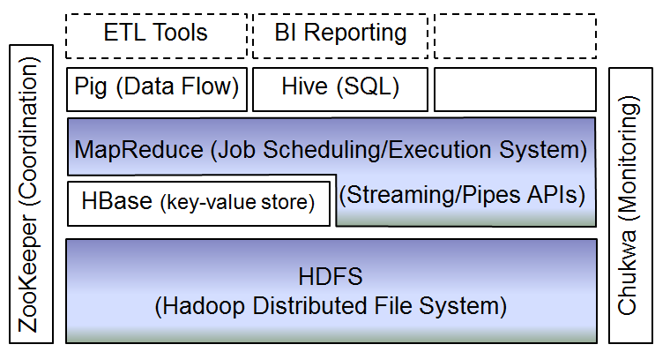
Batch Analysis
Unlimited scale
Jobs run for a few minutes to hours, days
Hadoop
HDFS + MapReduce
Java
Original
Architecture

Slide 54
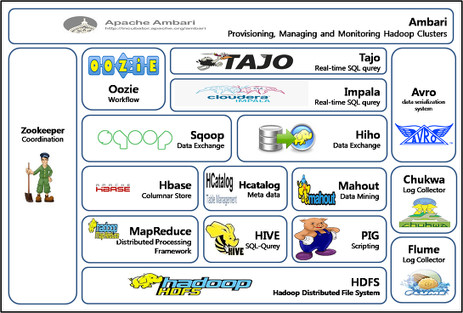
**Hadoop Eco System

Slide 55
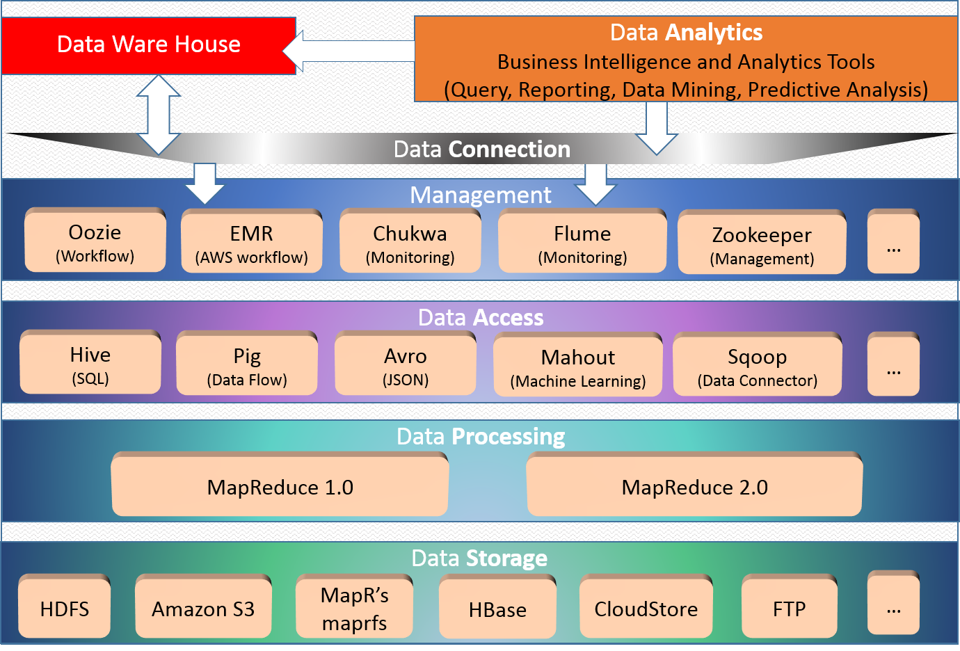
**Hadoop Eco System

Slide 56
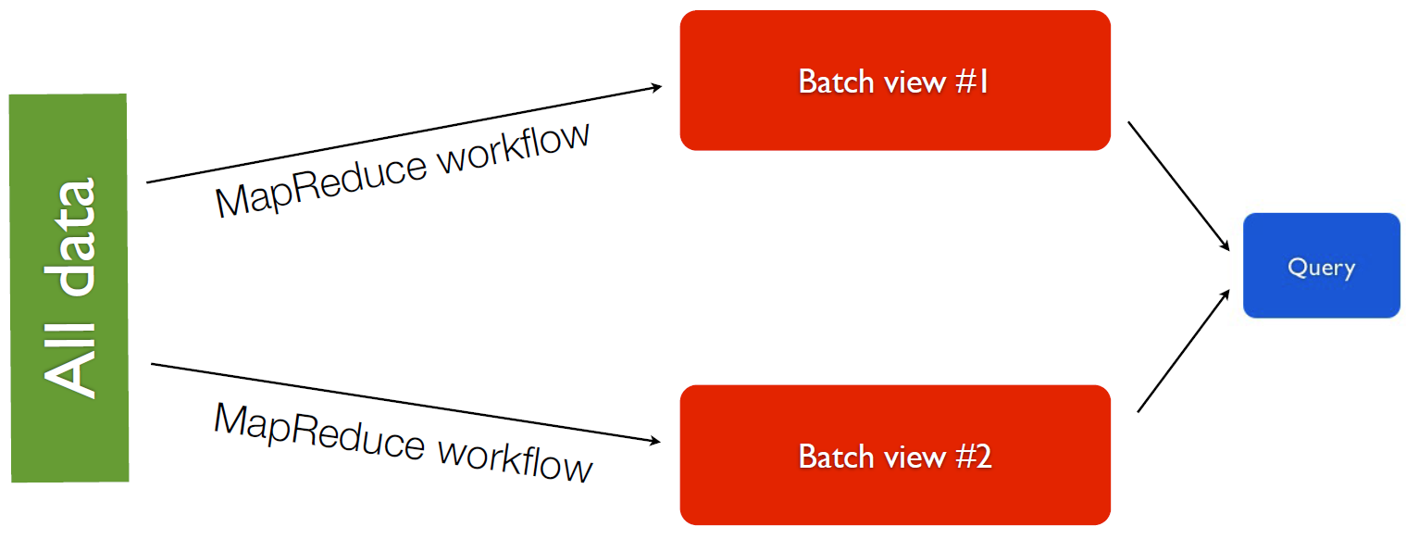
Batch Analysis
Query Input
All data
Too slow: “all data” is peta-byte scale
Precomputed view

Slide 57
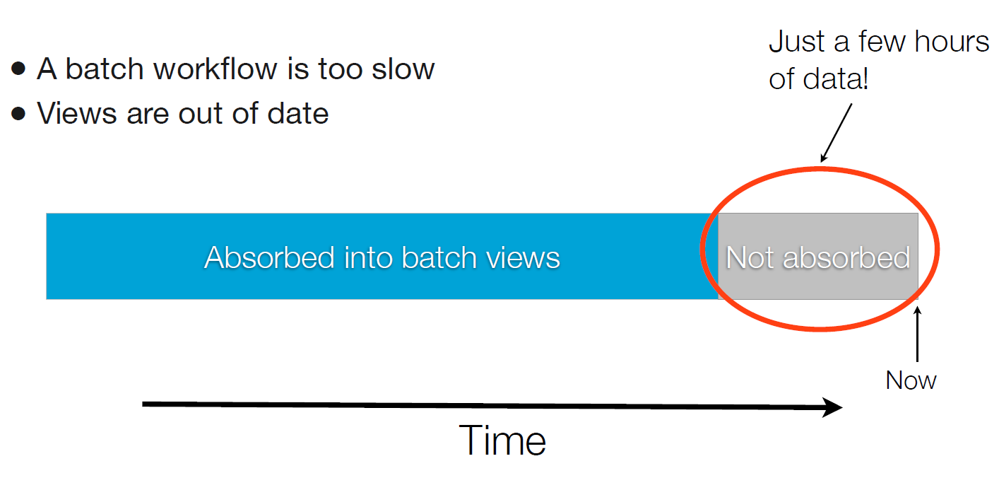
Batch Analysis
Fast action is the key of success in big data age
Time is money

Slide 58
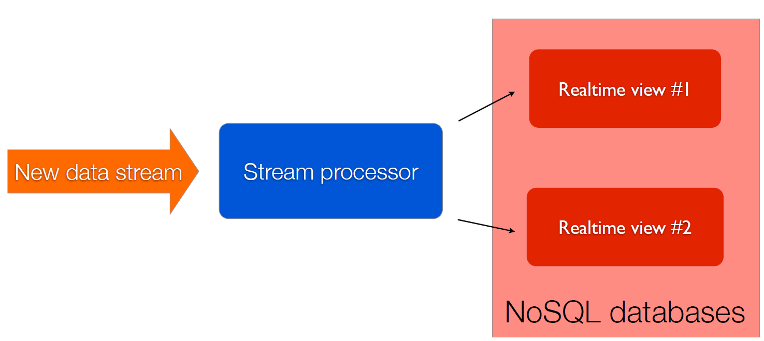
Real Time Analysis

Slide 59
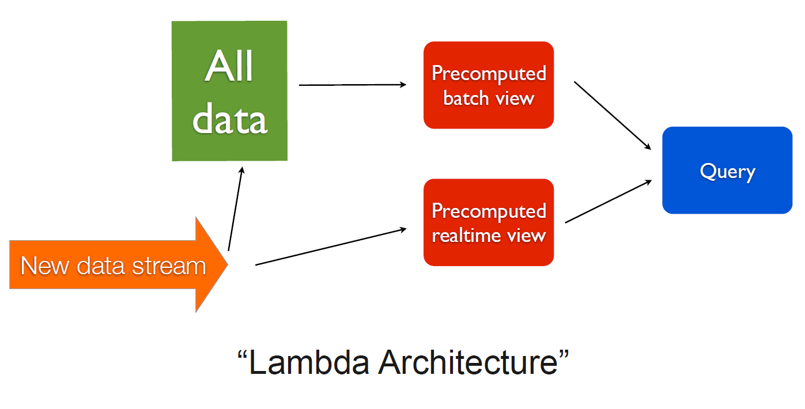
Real Time Analysis

Slide 60
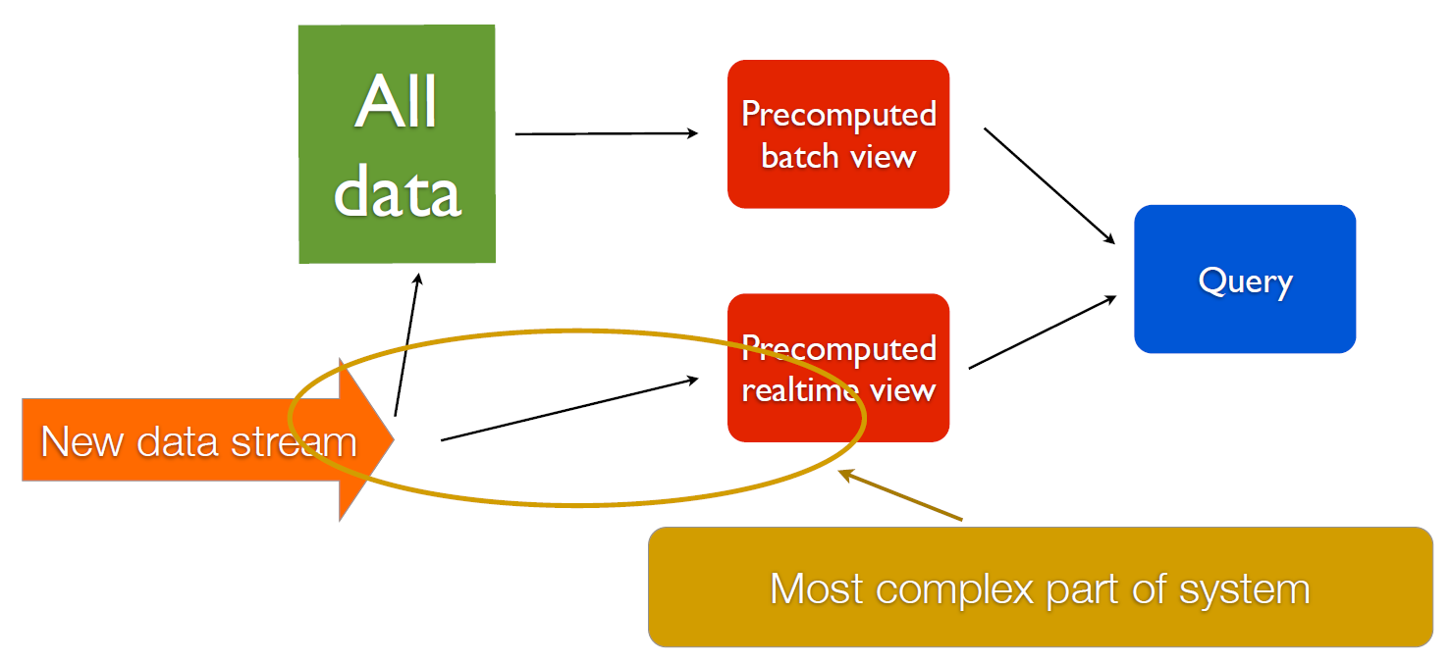
Real Time Analysis

Slide 61
Real Time Analysis
Big Data Trend
Real Time
Analysis
Bigger Data
Longer
Batch Time
Accuracy
- Batch > Real Time
Speed
- Real Time > Batch
mathematics & statistics
Hadoop Batch Analysis
Hadoop is about to include real time analysis in it’s territory

Slide 62
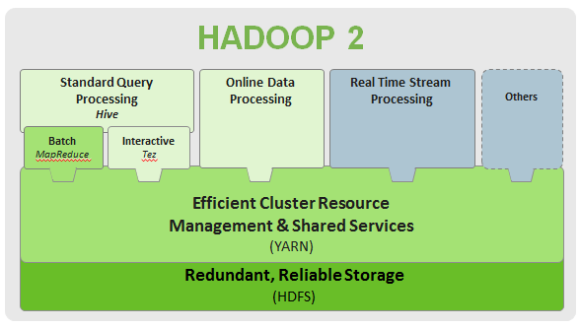

Real Time Analysis
VS
NoSQL DBMS

Slide 63
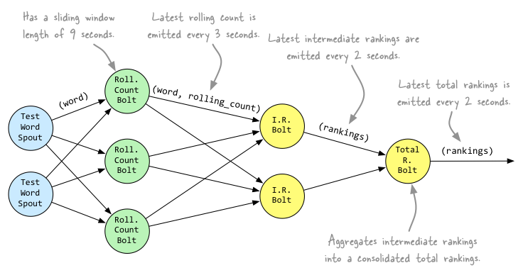
Apache Storm
Real time Data Stream Analysis Framework
Real time version of Hadoop
Processing Model: DAG
1 Analysis Job : 1 Topology
1 Topology have
Multiple spouts
Multiple bolts
Spout
Data entrance
Bolt
Data processor
Propagate stream

Slide 64
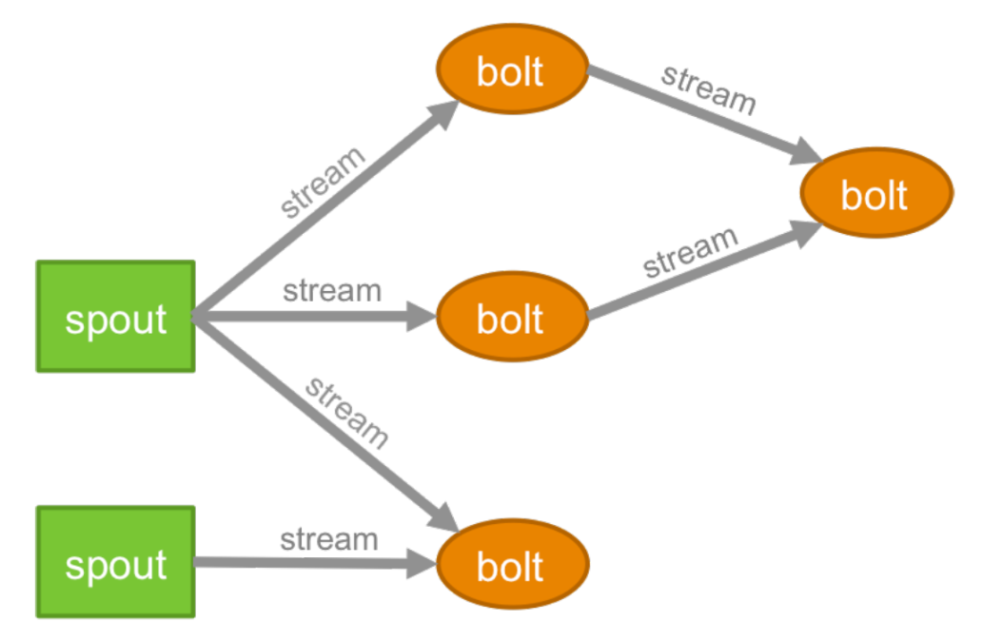

Storm Topology

Slide 65
Storm Component
Zookeeper
Store all state data
Nimbus
Single Master Node
Fail Fast
Distribute application code across workers
Supervisor
Worker node
Execute task: Spout / Bolt

Slide 66
**Topology Deployment
/> storm jar mytopology.jar com.MyTopology.main arg

Slide 67
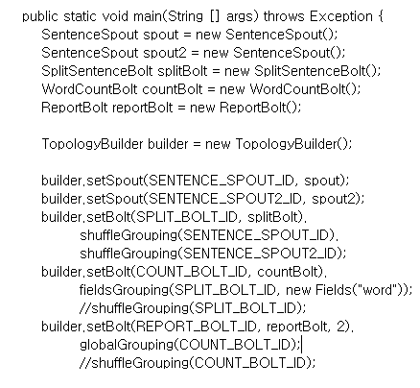
storm cluster
workers
nimbus
zookeeper
my_application.jar

Slide 68
Code Example

Slide 69
Storm Parallel Processing
Worker
Number of JVM Process
Executor
Number of thread in 1 worker process
Task
Number of task per component
For future scalability not for parallelism

Slide 70
**Parallel Processing
Node 1
Node 2
Node 3
Node 4
at runtime, nimbus choose two nodes
set number of worker: 2
set number of executor: 4
each worker create 2 threads
worker
worker
bolt A
executor
executor
bolt A
bolt A
executor
executor
bolt A

Slide 71
Grouping
Shuffle
Equally distribute tuples across parallel bolts
Field
Routes tuples to bolt based on the values of the specified field.
cf) group by
All
Broadcast all tuples to bolts
Global
Route all tuples to a single bolt executor

Slide 72
bolt B
spout
bolt A
bolt C
bolt D
t1
bolt A1
“A”,”B”
shuffle
grouping
t2
bolt A2
“A”,”B”
t3
“A”,”A”,”A”,”A”,”B”,”B”,
“C”,”B”,”D”,”D”
bolt A3
“A”,”C”,”D”
t4
bolt A4
“A”,”B”,”D”

Slide 73
bolt B
spout
bolt A
bolt C
bolt D
“A”
bolt A1
“A”,”A”,”A”,”A”
field
grouping
“B”
bolt A2
“B”,”B”,”B”
“C”
“A”,”A”,”A”,”A”,”B”,”B”,
“C”,”B”,”D”,”D”
bolt A3
“C”
“D”
bolt A4
“D”,”D”

Slide 74
bolt B
spout
bolt A
bolt D
bolt C
t
bolt A1
“A”,”A”,”A”,”A”,”B”,”B”,
“C”,”B”,”D”,”D”
all
grouping
t
bolt A2
“A”,”A”,”A”,”A”,”B”,”B”,
“C”,”B”,”D”,”D”
t
“A”,”A”,”A”,”A”,”B”,”B”,
“C”,”B”,”D”,”D”
bolt A3
“A”,”A”,”A”,”A”,”B”,”B”,
“C”,”B”,”D”,”D”
t
bolt A4
“A”,”A”,”A”,”A”,”B”,”B”,
“C”,”B”,”D”,”D”

Slide 75
bolt B
spout
bolt A
bolt D
bolt C
t
bolt A1
“A”,”A”,”A”,”A”,”B”,”B”,
“C”,”B”,”D”,”D”
global
grouping
bolt A2
“A”,”A”,”A”,”A”,”B”,”B”,
“C”,”B”,”D”,”D”
bolt A3
bolt A4

Slide 76
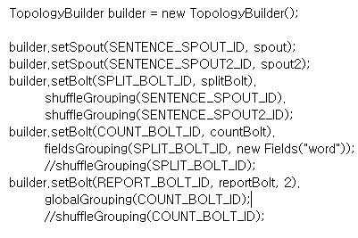
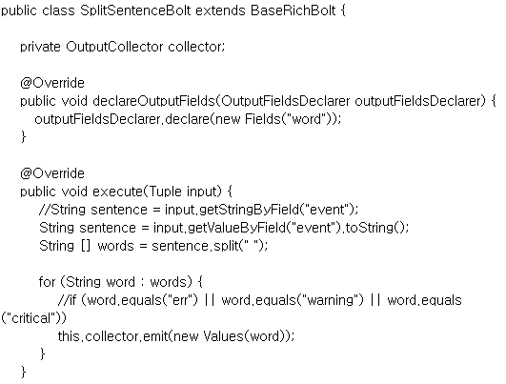
example code

Slide 77
Architecture Proposal

Slide 78

service1
service2
service3
flume
custom library
flume
flume
Log Agent
Log Agent
Log Agent
kafka producer API
kafka producer API
kafka producer API
service log
REDIS for STORM,
Provisioning
GIT / Chef
Developer, Operator
kafka topic
kafka topic
kafka topic
messenger service
single node
multi broker
custom
trident kafka spout
e -mail
XMPP
critical log filter
service
Web Viewer
cluster
SMTP Mailing
server
Mongo DB
service
Search
server
server
analysis result
server
Batch Backup Storage
service
Apps

Slide 79

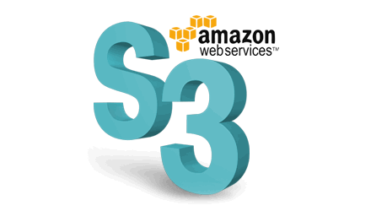
service1
service2
service3
flume
custom library
flume
flume
Log Agent
Log Agent
Log Agent
kinesis service API
kinesis service API
kinesis service API
service log
kinesis
stream 1
kinesis shards
REDIS for STORM,
Provisioning
GIT / Chef
critical error alarm
1st Filter
Critical Error Alarm
S3/ES export
Storm spout
EC2
auto scaling group
kiness application
kiness application
kiness application
S3 connector
service
kinesis
storm spout
custom
trident spout
cluster
analysis result
Mongo DB
EC2
kinesis
stream 2
kinesis shards
EC2
EC2
EC2
EC2
latency ?

Slide 80
Provisioning

Slide 81
Virtual Server Provisioning
Manage Server Configuration
Application Image
Deploy binary image(newer than snapshot) to new EC2 instance
Deploy updated binary image to running instance
Service Configuration
Change tomcat configuration on demand
Change service specific settings
Version Management
Revert to old binary image
Reset with old settings

Slide 82
Semi Automatic Provisioning
Internal Public GIT
Maintain Binary Image
Versioning Configuration File
Chef-Solo
Periodic GIT Pull
Template for Configuration File
Chef Resource Restart Using Template Change Notification
EC2 Instance Boot Time
Run Chef-Solo
EC2 Run Time
Periodic Chef-Solo Checking: Linux cron daemon

Slide 83
Image Update
Configuration Update
GIT revert
Service Control by Recipes
Provisioning
GIT / Chef
Web Server
GIT repo
Binary
Recipes
Configurations
rc.local
run chef-solo recipes
chef-solo
run recipes
GIT pull
chef-solo cron
GIT pull: update detect
restart service
EC2
auto scaling group
service
service
Scaled new instance service
Instance snapshot
GIT / Chef-solo recipes
Default Configurations
Note) GIT repo should be internally public - Do not use SSH
- Accessed by http

Slide 84
Query

Slide 85
To be continued.
Query
No SQL DBMS
- Mongo DB
Search Engine
- Elastic Search
Memory DB
- Redis
Visualization
- Kibana

